Slide 1
Image Processing Facial Attribute Recognition
Guided by: Mr. Ly Quoc Ngoc
Group: VPN
Luu Thi Hong Ngoc | 19127051
Ho Thien Phuoc | 19127517

Slide 2
Motivation
Performance table
Principle – Method – Algorithm
Problem statement
Installation
Challenges

Slide 3
Motivation
Scientific significance
We propose to take advantage of attribute relationships in three ways: by using MCNN sharing the lowest layers amongst 40 attributes(groups) before splitting the network into 6 branches, each one of which focuses on a certain attribute group; sharing the higher layers for related attributes(different attributes belonging to the same group); and by building an auxiliary network(AUX) on top of the MCNN which utilizes the scores from all attributes to improve the final classification of each attribute.
Application
HCI required information about gender require information about gender.
Expression in order to determine the mood of the user.
Identity verification in low quality imagery to automatically search for suspects in surveillance video.

Slide 4
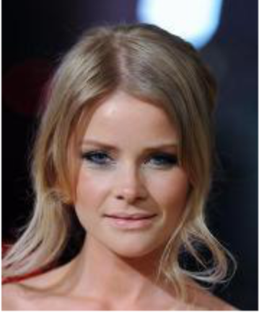
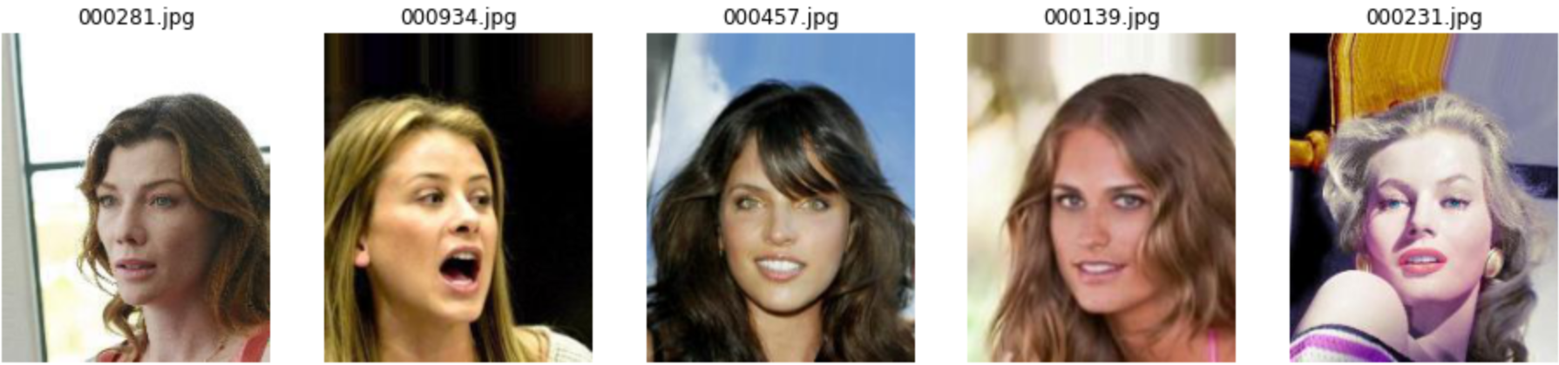
Problem statement - Input, output
Input: a face image (an attribute vector)
Output: set of face images for each attribute vectors which represent each images, are similar to attribute vector of input.

Slide 5
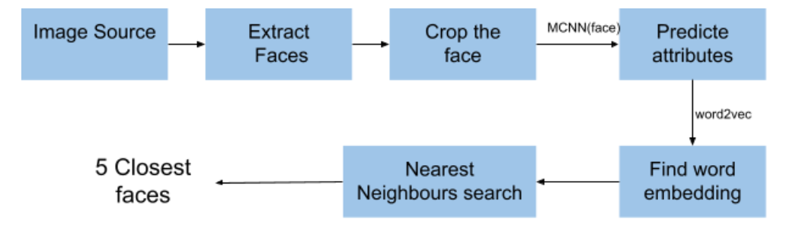
Problem statement - Framework

Slide 6
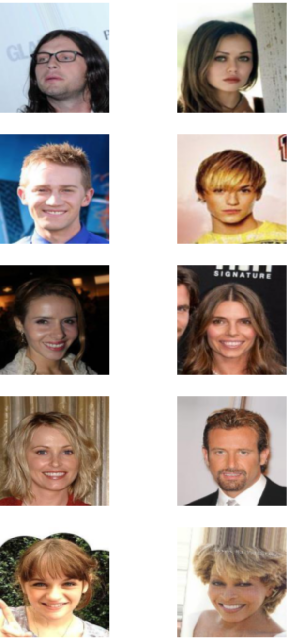
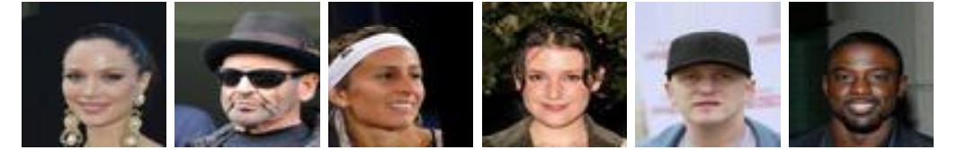
Problem statement - Standard Dataset
CelebA
CelebA dataset consists of 200k images respectively with 160k, 20k, and 20k images for training, validation, and testing sets. CelebA dataset provide the same 40 binary attributes.

Slide 7
Problem statement - Challenges
Datasets are extremely challenging, with large variations in subject pose, illumination and image quality.
Improving the accuracy of attribute classifiers

Slide 8
Performance table
(Document attachment https://docs.google.com/document/d/1Xp2_NOgoSk9KfOiv79cZ6bH2qlx6s3SElQan3SHJhnY/edit?usp=sharing)

Slide 9
MCNN - Principle
The input image is cropped to 227x227 and the training mean is subtracted. The image is then passed through the convolution layers and the fully connected layers to produce attribute scores. The attribute scores are then thresholded to give a yes or no answer. The red attributes indicate a lack of the attribute and the green attributes indicate a positive instance.

Slide 10
MCNN and AUX - Method
There are two parts to this solution
Face Attributes: Design a CNN that gives the facial attributes, given a face image
Face Similarity: Represent the face attributes in a vector space and use this to find similar faces

Slide 11
MCNN and AUX - Method
M (Multi-task learning)
Used to facial landmark localization, pose estimation, action recognition, face detection, and many more
40 attributes share the lower layers in the CNN, so that information common to 40 the attributes can be learned. Applying M to attribute prediction is very natural given the strong relationships among the facial attributes.
(See more detail in document attachment https://docs.google.com/document/d/1Xp2_NOgoSk9KfOiv79cZ6bH2qlx6s3SElQan3SHJhnY/edit?usp=sharing)

Slide 12
MCNN and AUX - Method
CNN
utilized a large dataset and applied both a siamese deep CNN and a classification CNN in order to maximize the distance between impostors and minimize the distance between true matches.
(See more detail in document attachment https://docs.google.com/document/d/1Xp2_NOgoSk9KfOiv79cZ6bH2qlx6s3SElQan3SHJhnY/edit?usp=sharing)

Slide 13
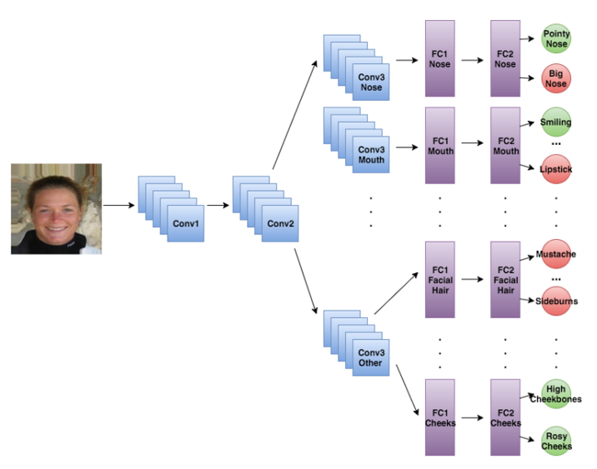
MCNN and AUX- Method
MCNN
A multi-task deep CNN for attribute classification.
Take an image as input and outputs 40 separate attribute scores, which are then thresholded to obtain binary outputs.
(See more detail in document attachment https://docs.google.com/document/d/1Xp2_NOgoSk9KfOiv79cZ6bH2qlx6s3SElQan3SHJhnY/edit?usp=sharing)

Slide 14
MCNN and AUX- Method
AUX
an auxiliary network for MCNN which allows for learning of attribute relationships at the score level
(See more detail in document attachment https://docs.google.com/document/d/1Xp2_NOgoSk9KfOiv79cZ6bH2qlx6s3SElQan3SHJhnY/edit?usp=sharing)

Slide 15
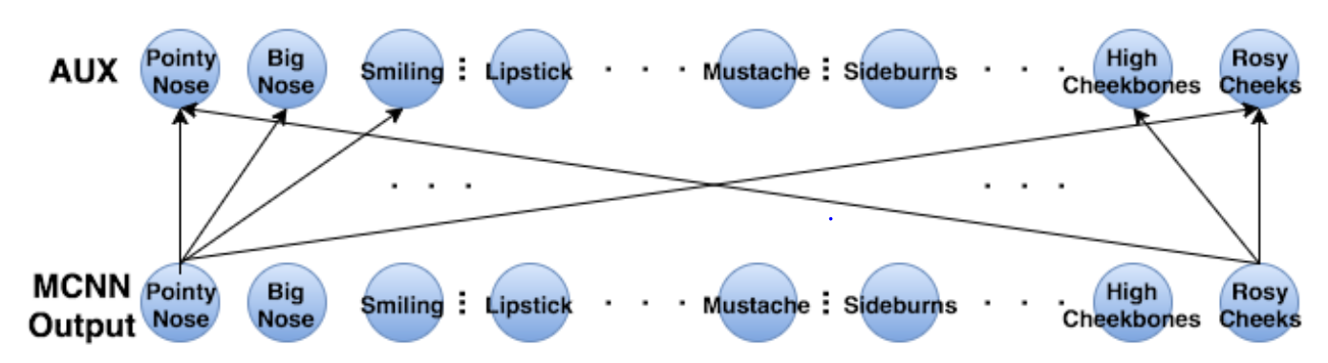
MCNN and AUX- Method
Combine MCNN and AUX to create MCNN-AUX, a multi-task attribute network which utilizes implicit and explicit attribute relationships for improved classification.
(See more detail in document attachment https://docs.google.com/document/d/1Xp2_NOgoSk9KfOiv79cZ6bH2qlx6s3SElQan3SHJhnY/edit?usp=sharing)

Slide 16
MCNN and AUX Algorithm
Our idea for looking for similar faces is to use the attributes of each face to get a vector representation for it. For this I have trained a word2vec using training set. Given the vector space for each face, it's easy to find nearby faces in the vector space.
(Source code attachment )​

Slide 17
Installation - Environment
Programming language: Python
Tool:
Anaconda Installer: Installing on Windows — Anaconda documentation
Install Jupyter Notebook: Project Jupyter | Installing Jupyter Software
Install torch, pytorch

Slide 18
Installation - Environment
Open Anaconda Prompt, follows below command to open Jupyter Notebook:
jupyter notebook

Slide 19
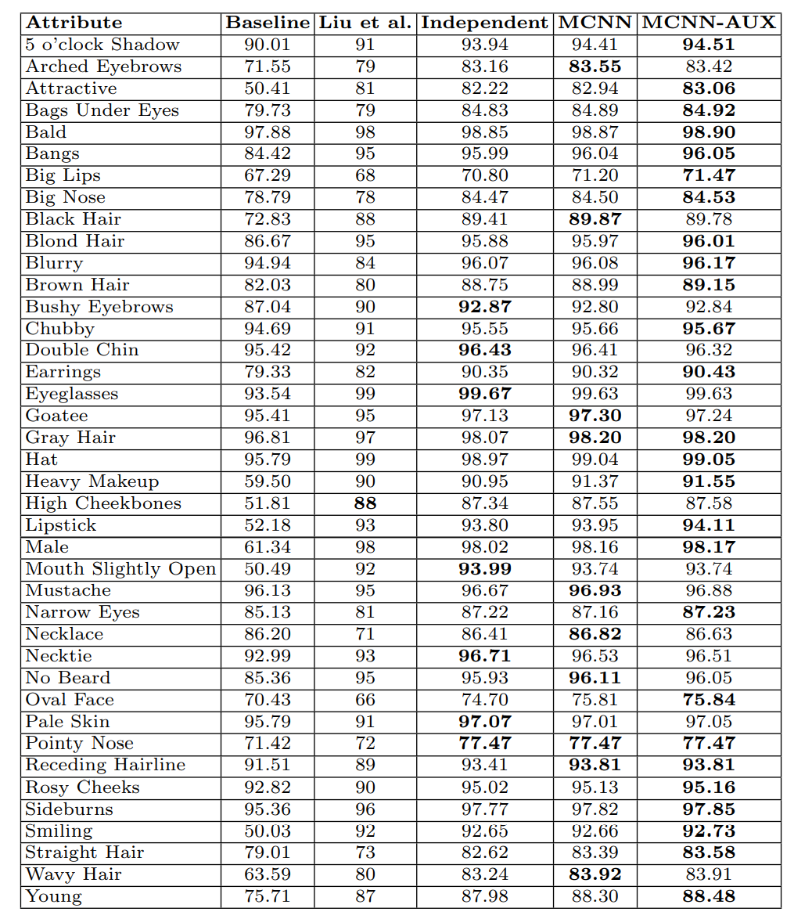
Installation - Result

Slide 20
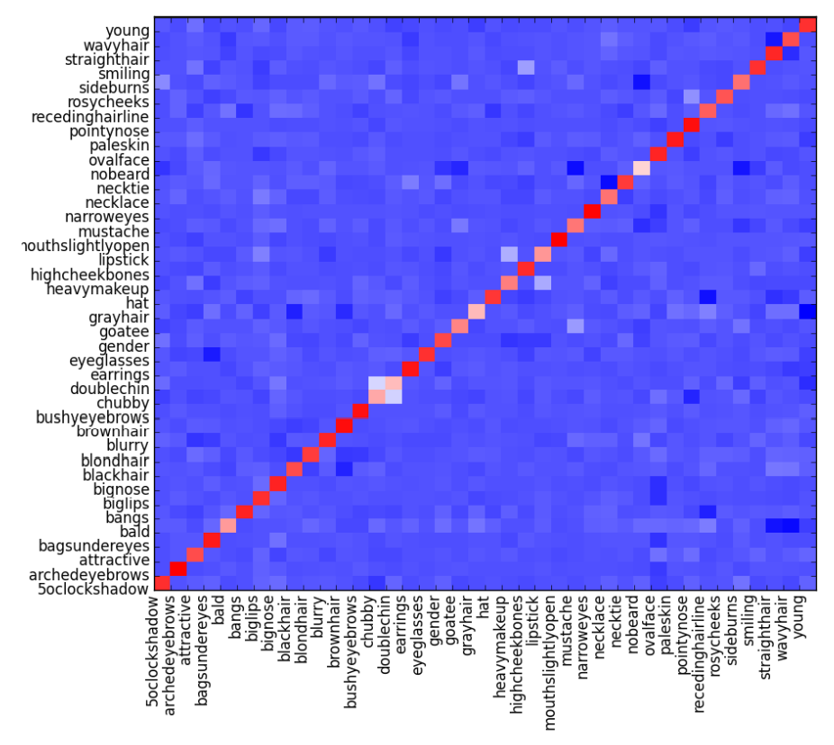
Installation - Result

Slide 21
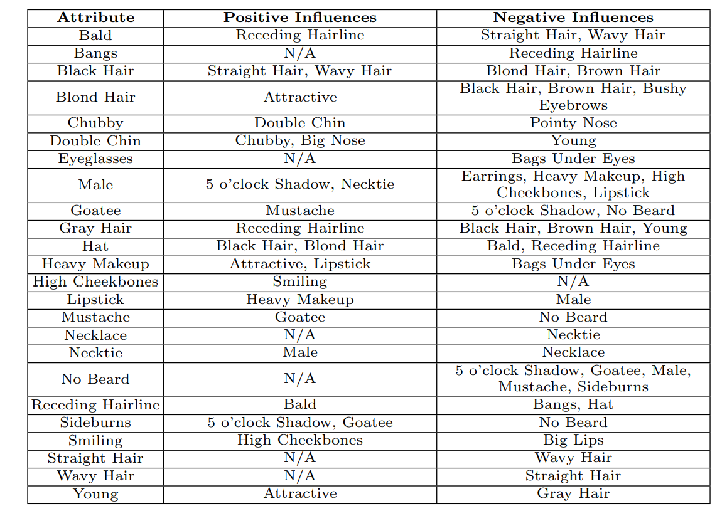
Installation - Result

Slide 22
Installation - Result
Publication
Approach
Dataset
Accuracy

Slide 23
Installation – Result Comment
achieve state-of-the-art performance for many attributes, some showing up to a 15% improvement over other methods
skipping alignment or part extraction in the preprocessing stage which are expensive and error-prone processes.
significantly decrease the number of parameters – over four times - and the amount of training time - over 16 times - required for the attribute classifier.
(See more result comments in Document attachment https://docs.google.com/document/d/1Xp2_NOgoSk9KfOiv79cZ6bH2qlx6s3SElQan3SHJhnY/edit?usp=sharing)

Slide 24
Responsibility
(Document attachment Personal information - Google Drive)

